Slide 1
Computer Logic & Design
Waqar
Lecture 04
Copyrights: Dr Waseem Ikram

Slide 2
Recap
Octal Number System
Alternate Representations
  Excess Code
  BCD Code
  Gray Code
Alphanumeric Code (ASCII)
Error Detection using Parity Bit

Slide 3
Logic Gates
Basic Building Blocks
Logic Gate Symbol
Unique function
Truth or Function Table
Function Expression
Timing Diagram

Slide 4
Binary Logic and Gates
Binary variables take on one of two values.
Logical operators operate on binary values and binary variables.
Basic logical operators are the logic functions AND, OR and NOT.
Logic gates implement logic functions.
Boolean Algebra: a useful mathematical system for specifying and transforming logic functions.
We study Boolean algebra as a foundation for designing and analyzing digital systems!
3

Slide 5
Logical Operations
The three basic logical operations are:
  AND
  OR
  NOT
AND is denoted by a dot (·).
OR is denoted by a plus (+).
NOT is denoted by an overbar ( ¯ ), a single quote mark (') after, or (~) before the variable.
Chapter 2 - Part 1

Slide 6
Notation Examples
Examples:
  Y=A.B is read “Y is equal to A AND B.”
  z ⁼ x + y is read “z is equal to x OR y.”
is read “X is equal to NOT A.”
X = A
Note: The statement:
1 + 1 = 2 (read “one plus one equals two”)
is not the same as
1 + 1 = 1 (read “1 or 1 equals 1”).
Chapter 2 - Part 1

Slide 7
Operator Definitions
Operations are defined on the values "0" and "1" for each operator:
AND
0 · 0 = 0
0 · 1 = 0
1 · 0 = 0
1 · 1 = 1
OR
0 + 0 = 0
0 + 1 = 1
1 + 0 = 1
1 + 1 = 1
NOT
0 = 1
1 = 0
Chapter 2 - Part 1

Slide 8

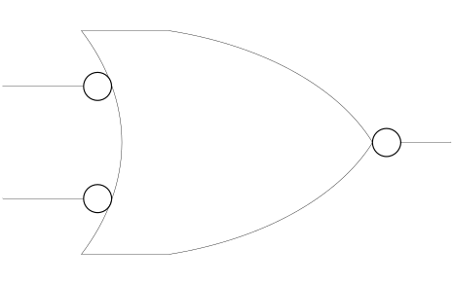
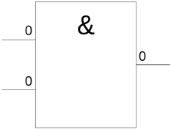
AND Gate
1 output
2 inputs
3 inputs
4 inputs
Multiple inputs

Slide 9

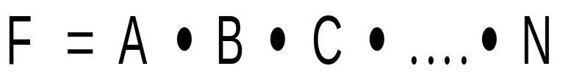
AND Gate function
Logical Multiplication function
Input |  | Output
A | B | F
0 | 0 | 0
0 | 1 | 0
1 | 0 | 0
1 | 1 | 1

Slide 10
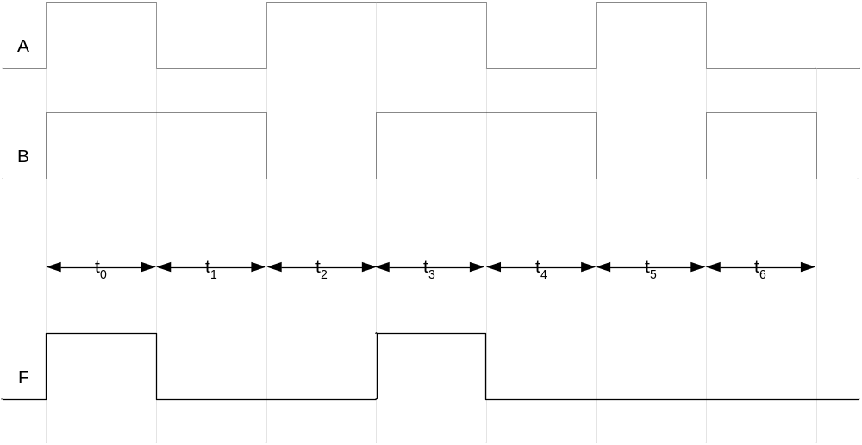
AND Gate Timing Diagram

Slide 11
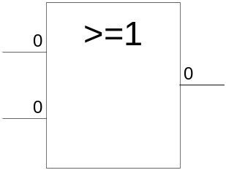

OR Gate
1 output
2 inputs
3 inputs
4 inputs
Multiple inputs

Slide 12

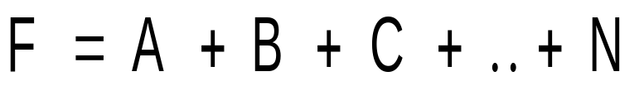
OR Gate function
Boolean Add function
Input |  | Output
A | B | F
0 | 0 | 0
0 | 1 | 1
1 | 0 | 1
1 | 1 | 1

Slide 13
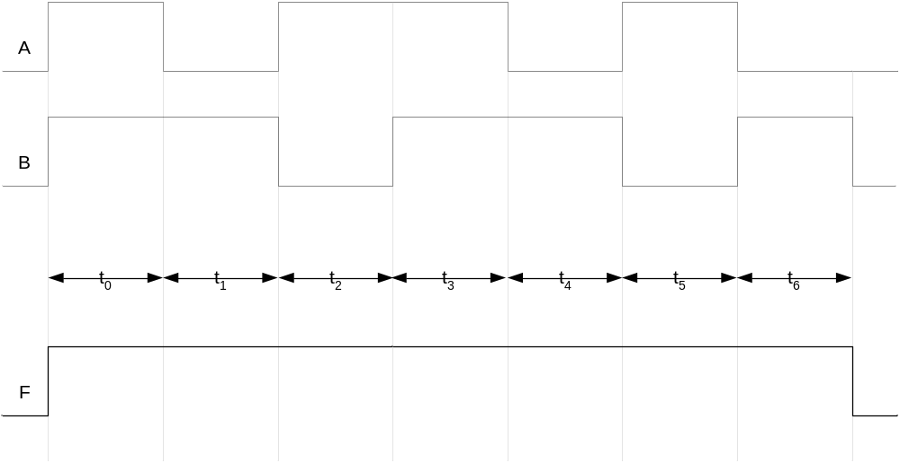
OR Gate Timing Diagram

Slide 14
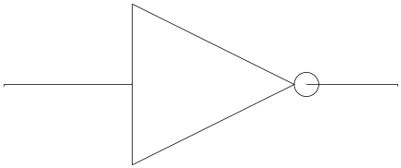
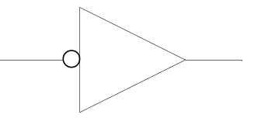
NOT Gate
1 input
1 output

Slide 15
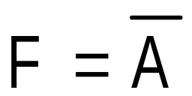
NOT Gate function
Invert function
Input | Output
A | F
0 | 1
1 | 0

Slide 16
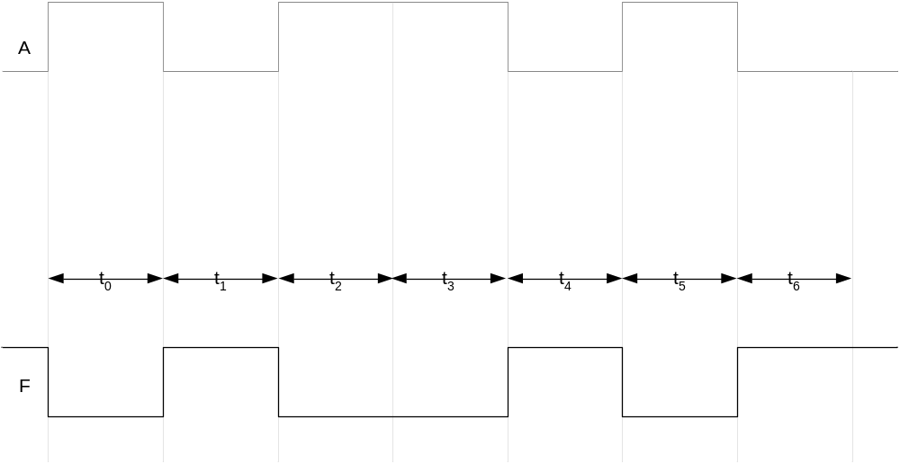
NOT Gate Timing Diagram

Slide 17
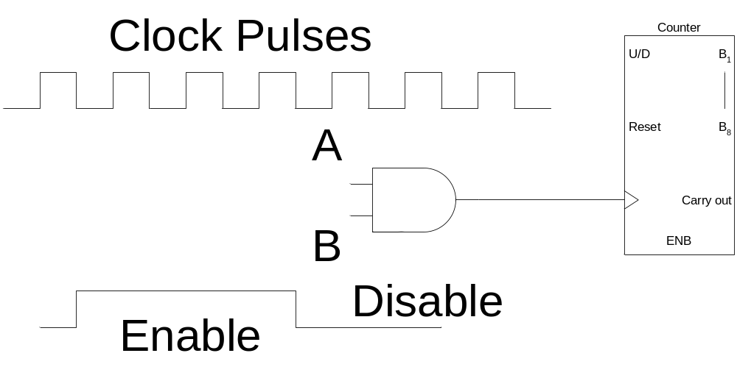
AND Gate Applications
Enable/Disable Device
  Counter counts when it receives pulses

Slide 18
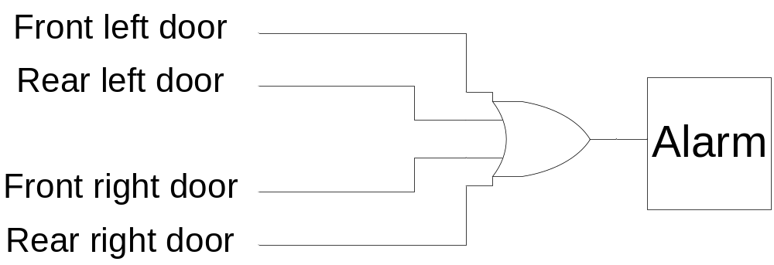
OR Gate Applications
Car door open alarm

Slide 19
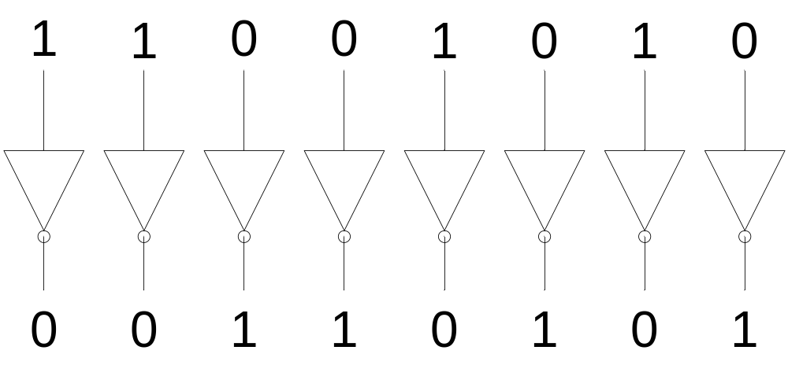
NOT Gate Applications
1’s Complement

Slide 20
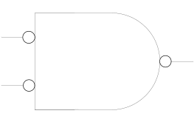
Alternate Representations

Slide 21

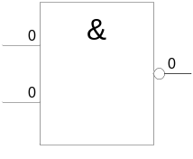

NAND Gate
1 output
2 inputs
3 inputs
4 inputs
Multiple inputs

Slide 22
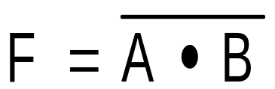
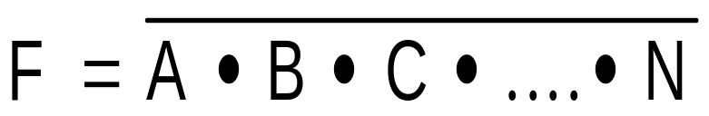
NAND Gate function
NOT-AND function
Input |  | Output
A | B | F
0 | 0 | 1
0 | 1 | 1
1 | 0 | 1
1 | 1 | 0

Slide 23
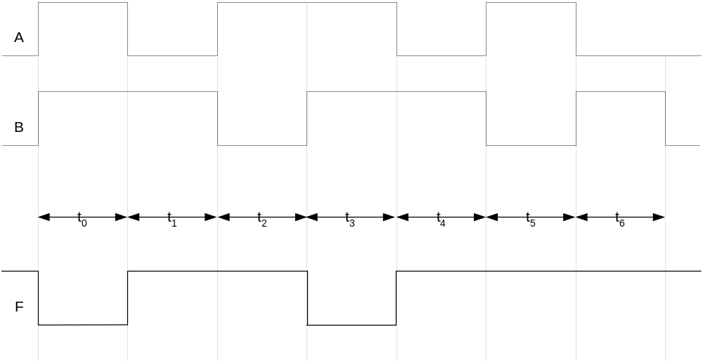
NAND Gate Timing Diagram

Slide 24
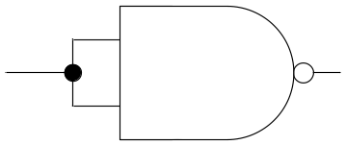
NAND Universal Gate
Input |  | Output
A | B | F
0 | 0 | 1
0 | 1 | 1
1 | 0 | 1
1 | 1 | 0

Slide 25
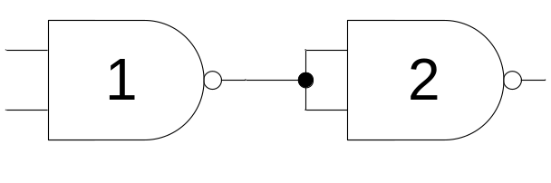
NAND Universal Gate
Input |  | Output | Output
A | B | F1 | F
0 | 0 | 1 | 0
0 | 1 | 1 | 0
1 | 0 | 1 | 0
1 | 1 | 0 | 1

Slide 26
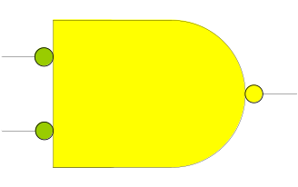
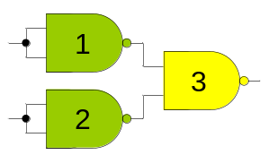
NAND Universal Gate
Input |  | Output
A | B | F
0 | 0 | 0
0 | 1 | 1
1 | 0 | 1
1 | 1 | 1

Slide 27
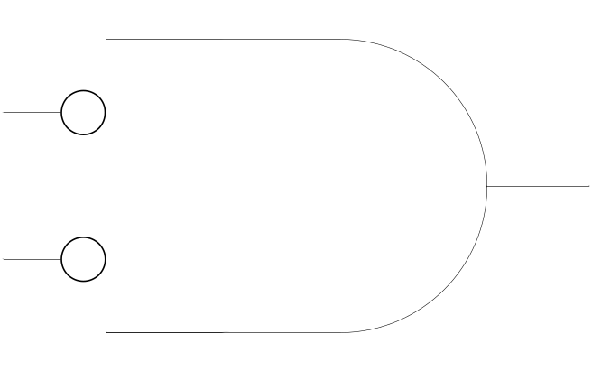

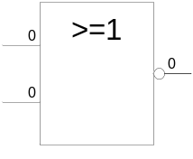
NOR Gate
1 output
2 inputs
3 inputs
4 inputs
Multiple inputs

Slide 28
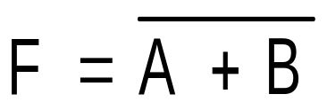
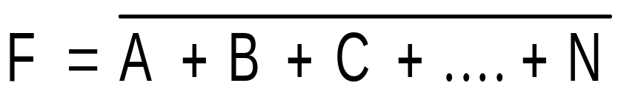
NOR Gate function
NOT-OR function
Input |  | Output
A | B | F
0 | 0 | 1
0 | 1 | 0
1 | 0 | 0
1 | 1 | 0

Slide 29
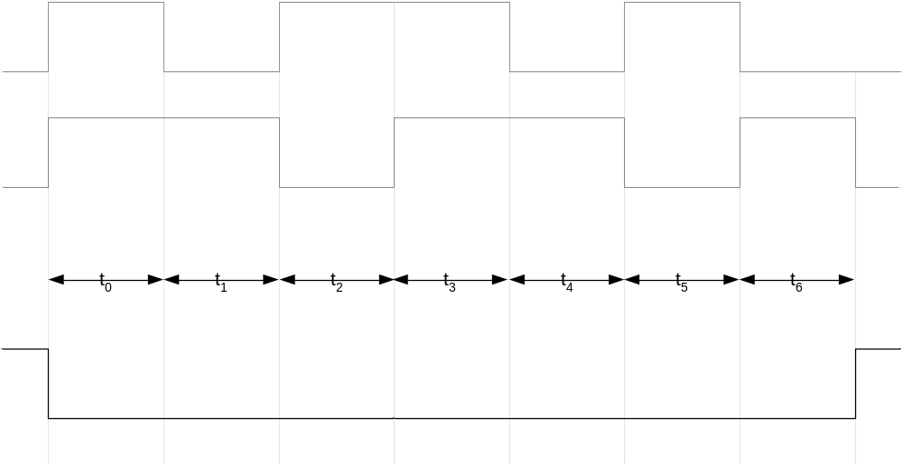
NOR Gate Timing Diagram

Slide 30
Recap
Logic Gates Basic Building Blocks
Symbol
Performs unique function
Represented by a function/truth table
Function expression
Timing Diagram

Slide 31
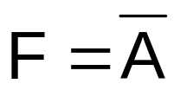
Recap
AND Gate F=A.B
OR Gate F=A+B
NOT Gate
AND Gate enables/disables device
OR Gate car door alarm system
NOT Gate 1’s complement

Slide 32


Recap
Alternate Symbolic representations
NAND Gate
NOT-AND operation
Universal NAND Gate
NOR Gate
NOT-OR operation
Universal NOR Gate

Slide 33
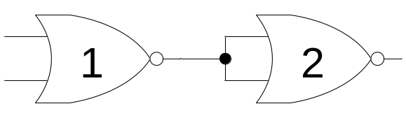
NOR Universal Gate as OR
Input |  | Output
A | B | F
0 | 0 | 0
0 | 1 | 1
1 | 0 | 1
1 | 1 | 1

Slide 34
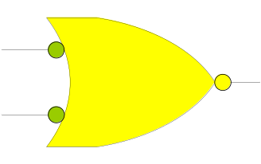
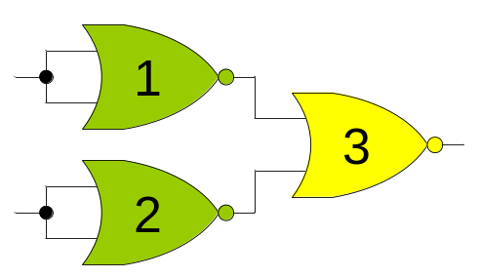
NOR Universal Gate as AND
Input |  | Output
A | B | F
0 | 0 | 0
0 | 1 | 0
1 | 0 | 0
1 | 1 | 1

Slide 35
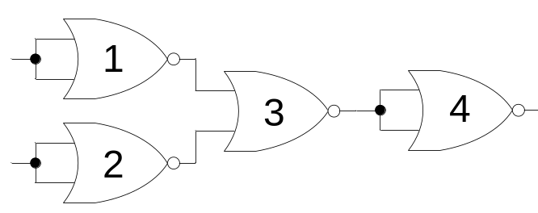
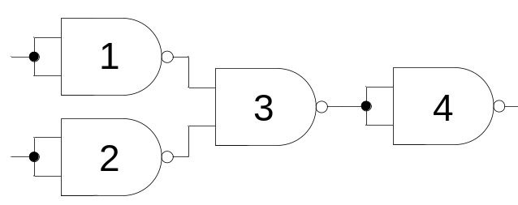
NAND-NOR Universal Gate

Slide 36
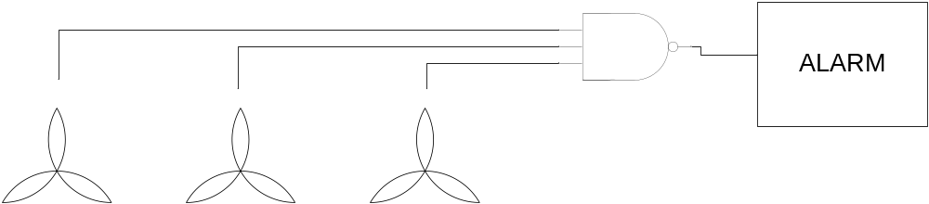
NAND Gate Applications
Device Failure Alarm
Notes:
Toxic fumes produced by the chemicals are removed from the ware house and dispersed in the atmosphere through three exhaust fans.
When all fans are working the input to the NAND gate is 111 and the output is 0
When any one fan fails the output of NAND gate becomes 1 sounding an alarm connected tot the output of the NAND gate.

Slide 37
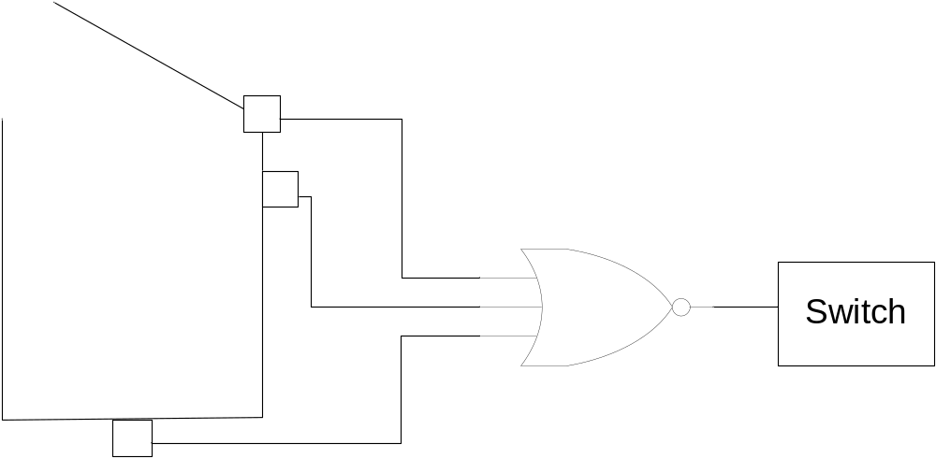
NOR Gate Applications
Washing Machine Controller
If the lid is open or the water is below the minimum level or the washing machine has been overloaded the appropriate sensor sets its output to 1
Notes:
Three sensors check for washing machine lid open, washing tub filled to minimum level and weight of cloths and water in the tub.
If the lid is open or the water is below the minimum level or the washing machine has been overloaded the appropriate sensor sets its output to 1. The NOR gate output is set to 0 switching off the washing machine.

Slide 38

XOR Gate
1 output
2 inputs
Multiple inputs

Slide 39

XOR Gate function
Input |  | Output
A | B | F
0 | 0 | 0
0 | 1 | 1
1 | 0 | 1
1 | 1 | 0
Notes:
Comparator .. Similar Outputs 0, non similar =1, half adder

Slide 40
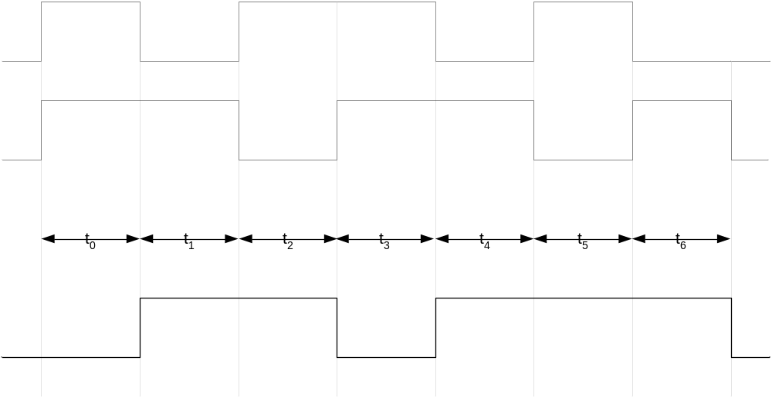
XOR Gate Timing Diagram

Slide 41
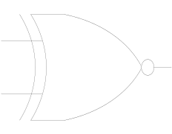
XNOR Gate
1 output
2 inputs
Multiple inputs

Slide 42
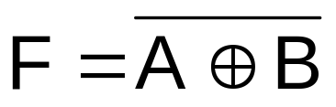
XNOR Gate function
Input |  | Output
A | B | F
0 | 0 | 1
0 | 1 | 0
1 | 0 | 0
1 | 1 | 1
Notes:
Similar outputs 1

Slide 43
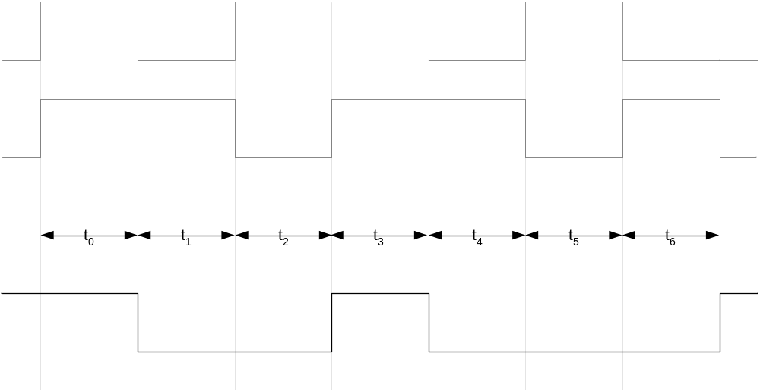
XNOR Gate Timing Diagram

Slide 44
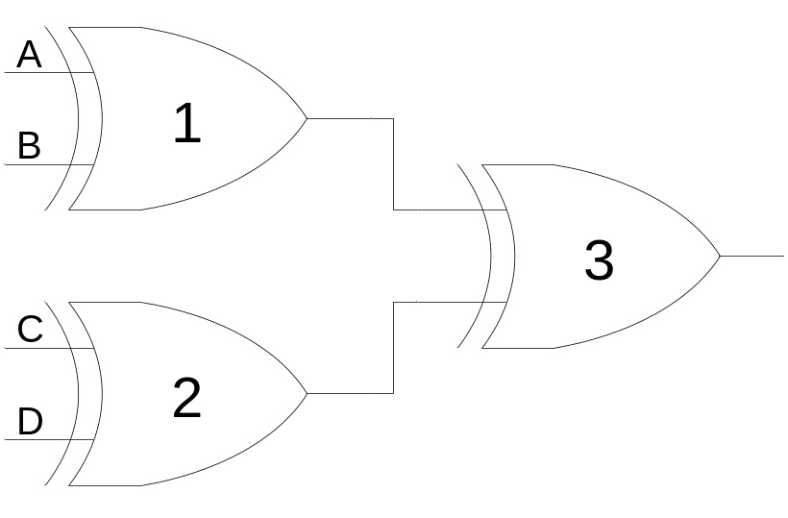
XOR Gate Applications
Detecting odd number of 1’s
Notes:
Consider the three XOR gate logic circuit which is used to detect odd number of 1’s in a 4-bit binary input combination
Consider the 4-bit binary number 0000 applied at the inputs A, B, C and D respectively of XOR gates 1 and 2.
The output of XOR Gates 1 and 2 is 0 and 0. The output of XOR gate 3 is also zero.
Consider the binary number 0011 applied at the inputs A, B, C and D respectively. The output of XOR gate 1 with inputs 00 is 0. The output of XOR gate 2 with inputs 11 is 0. The output of gate 3 is 0. Thus the output indicates that the binary number 0011 does not have odd number of 1’s
Consider the binary number 1011 applied at the inputs A, B, C and D respectively. The output of XOR gate 1 with inputs 10 is 1. The output of XOR gate 2 with inputs 11 is 0. The output of gate 3 is 1. Thus the output indicates that the binary number 1011 has odd number of 1’s

Slide 45

XNOR Gate Applications
Detecting even number of 1’s
Notes:
Consider the two XOR and a single XNOR gate based logic circuit used to detect even number of 1’s in a 4-bit binary input combination
Consider the 4-bit binary number 0000 applied at the inputs A, B, C and D respectively of XOR gates 1 and 2.
The output of XOR Gates 1 and 2 is 0 and 0. The output of XNOR gate 3 is a 1.
Consider the binary number 0011 applied at the inputs A, B, C and D respectively. The output of XOR gate 1 with inputs 00 is 1. The output of XOR gate 2 with inputs 11 is 1. The output of XNOR gate 3 is also a 1. Thus the output indicates that the binary number 0011 has even number of 1’s
Consider the binary number 1011 applied at the inputs A, B, C and D respectively. The output of XOR gate 1 with inputs 10 is 1. The output of XOR gate 2 with inputs 11 is 0. The output of XNOR gate 3 is 0 because of dissimilar inputs. Thus the output indicates that the binary number 1011 does not have even number of 1’s

Slide 46
Gate Delay
In actual physical gates, if one or more input changes causes the output to change, the output change does not occur instantaneously.
The delay between an input change(s) and the resulting output change is the gate delay denoted by t_{G}:
Input ¹
0
t
t = 0.3 ns
t
G
G
1
0
G
Output
0
0.5
1
1.5
Time (ns)
Chapter 2 - Part 1

Slide 47
Boolean Algebra
Variable
Complement
Literal
Notes:
Variable: A variable is a symbol usually an uppercase letter used to represent a logical quantity.
A variable can have a 0 or 1 value.
Complement: A complement is the inverse of a variable and is indicated by a bar over the variable.
Complement of variable X is X*
If X = 0 then X*= 1 and if X = 1 then X*= 0
Literal: A Literal is a variable or the complement of a variable. X and X* are literals

Slide 48

Boolean Addition & Multiplication
Boolean Addition performed by OR gate
Sum Term describes Boolean Addition
Boolean Multiplication performed by AND gate
Product Term describes Boolean Multiplication

Slide 49
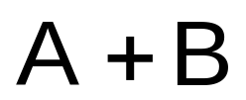
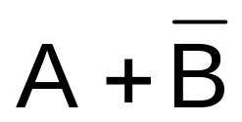
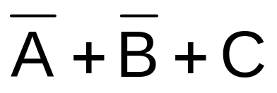
Boolean Addition
Sum of literals
Sum term = 1 if any literal = 1
Sum term = 0 if all literals = 0
Notes:
Sum term is described as sum of literals

Slide 50
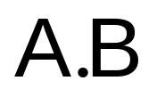
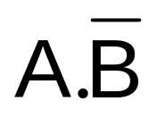
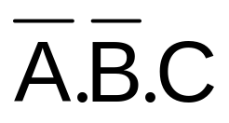
Boolean Multiplication
Product of literals
Product term = 1 if all literals = 1
Product term = 0 if any one literal = 0
Notes:
Product term is described as product of literals

Slide 51
Laws, Rules & Theorems of Boolean Algebra
Commutative Law
  for addition and multiplication
Associative Law
  for addition and multiplication
Distributive Law
Rules of Boolean Algebra
Demorgan’s Theorems

Slide 52
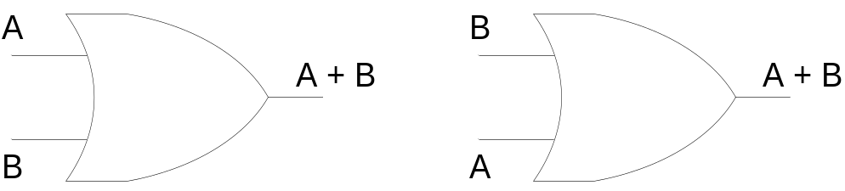
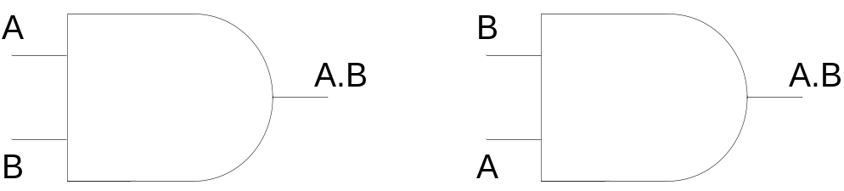
Commutative Law
Commutative Law for Addition
A + B = B + A
Commutative Law for Multiplication
A.B = B.A
Notes:
The basic laws of Boolean Algebra are the same as ordinary algebra and hold true for any number of variables

Slide 53
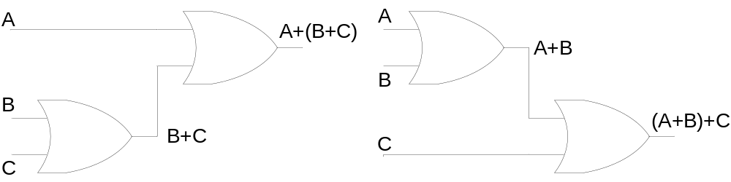
Associative Law
Associative Law for Addition
A + (B + C) = (A + B) + C
Notes:
The sum term B OR C Ored with A is the same as sum term A OR B Ored with C

Slide 54

Associative Law
Associative Law for Multiplication
A.(B.C) = (A.B).C
Notes:
The product term BC Anded with A is the same as AB Anded with C

Slide 55

Distributive Law
A.(B + C) = A.B + A.C

Slide 56




Rules of Boolean Algebra
A + 0 = A
A + 1 = 1
A.0 = 0
A.1 = A
A + A = A
A + = 1
A.A = A
A. = 0
= A
A + A.B = A
A + = A + B
(A+B).(A+C)
= A+B.C
Notes:
A+A*B = A(B+1)+A*B using rule 2
=AB+A+A*B
=A+AB+A*B
= A+B
(A+B)(A+C) = A+AC+AB+BC
=A+BC

Slide 57

Boolean Operator Precedence
The order of evaluation in a Boolean expression is:
  Parentheses
  NOT
  AND
  OR
Consequence: Parentheses appear around OR expressions
Example: F = A(B + C)(C+ D)
Chapter 2 - Part 1

Slide 58
Boolean Operator Precedence
The order of evaluation in a Boolean expression is:
  Parentheses
  NOT
  AND
  OR
Consequence: Parentheses appear around OR expressions
Example: F = A(B + C)(C+ D)
Chapter 2 - Part 1

Slide 59
Dual and Duality Principle
The dual of an expression is obtained by changing AND to OR and OR to AND throughout (and 1s to 0s and 0s to 1s if they appear in the expression).
The duality principle of Boolean algebra states that a Boolean equation remains valid if we take the dual of the expressions on both sides of the equals sign.
Example:
This can be written as below equation using duality principle.
Chapter 2 - Part 1
17

Slide 60
Example 1: Boolean Algebraic Proof
A + A·B = A
Proof Steps A + A·B
= A · 1 + A · B
= A · ( 1 + B)
= A · 1
= A
(Absorption Theorem)
Justification (identity or theorem)
X = X · 1
X · Y + X · Z = X ·(Y + Z)(Distributive Law)
1 + X = 1 X · 1 = X
Our primary reason for doing proofs is to learn:
  Careful and efficient use of the identities and theorems of Boolean algebra, and
  How to choose the appropriate identity or theorem to apply to make forward
progress, irrespective of the application.
Chapter 2 - Part 1
18

Slide 61
Distributive law
The multiplication of two variables and adding the result with a variable will result in same value as multiplication of addition of the variable with individual variables.
In other words, ANDing two variables and ORing the result with another variable is equal to AND of ORing of the variable with the two individual variables.
Distributive law can be written as
  A + BC = (A + B)(A + C)
This is called OR distributes over AND.
Chapter 2 - Part 1

Slide 62
Example 2: Proof of Distributive law
Theorem: A + BC = (A+B) (A+C)
Taking R.H.S: (A + B) (A + C)
=A.A + AC +AB + BC A + AC +AB +BC
A (1+ C + B) + BC A ( 1+ B) +BC
A (1) + BC A + BC
= L.H.S
1+C=1
1+B=1
Chapter 2 - Part 1

Slide 63

Example 3: Boolean Algebraic Proofs (consensus theorem )
The following consensus theorem is useful when simplifying Boolean expressions:
The theorem shows that the third term, YZ, is redundant and can be eliminated. Note that Y and Z are associated with X and X in the first two terms and appear together in the term that is eliminated. The proof of the consensus theorem is obtained by first ANDing YZ with (X + X) = 1 and proceeds as follows:
The dual of the consensus theorem is
Chapter 2 - Part 1

Slide 64
Useful Theorems
x ⋅ y + x ⋅ y = y
x + x ⋅ y = x
(x + y)(x + y)= y
x ⋅ (x + y) = x
Minimization
Absorption
• x + x⋅ y = x + y x ⋅ (x+ y)= x ⋅ y Simplification
•
x ⋅ y + x ⋅ z + y ⋅ z = x ⋅ y + x ⋅ z
Consensus
x + y = x ⋅ y
x ⋅ y = x + y
DeMorgan's Laws
Chapter 2 - Part 1

Slide 65




Demorgan’s Theorems
First Theorem
Second Theorem
Notes:
Demorgan’s First Theorem states: The complement of a product of variables is equal to the sum of the complements of the variables.
Demorgan;s Second Theorem states: The complement of sum of variables is equal to the product of the complements of the variables

Slide 66






Demorgan’s Theorems
Any number of variables
Combination of variables
Notes:
Demorgan’s Theorems can be applied to expressions having any number of variables
Demorgan’s Theorem can be applied to a combination of other variables

Slide 67
Boolean Analysis of Logic Circuits
Boolean Algebra provides concise way to represent operation of a logic circuit
Complete function of a logic circuit can be determined by evaluating the Boolean expression using different input combinations
Notes:
Boolean algebra provides a concise way to represent the operation of a logic circuit.
The complete function of the logic circuit can be determined by evaluating the Boolean expression using different input combinations.

Slide 68
Boolean Functions (1/2)
A Boolean function described by an algebraic expression consists of binary variables, the constants 0 and 1, and the logic operation symbols
F₁ = x + y’z
A Boolean function can be represented in a truth table
The number of rows in the truth table is 2^{n}, where n is the number of variables in the function
A Boolean function can be transformed from an algebraic expression into a circuit diagram (also called schematic) composed of logic gates connected in a particular structure
EE227 - DLD
Course Instructor : Muhammad Sajid Iqbal

Slide 69


Boolean Functions (2/2)
F₁ = x + y’z
EE227 - DLD
Course Instructor : Muhammad Sajid Iqbal

Slide 70


Practice Problem 3
Construct the truth table and circuit diagram for the following Boolean function
F₂ = x’y’z + x’yz + xy’
EE227 - DLD
Course Instructor : Muhammad Sajid Iqbal

Slide 71
Algebraic Manipulation (1/2)
When a Boolean expression is implemented with logic gates, each term requires a gate and each variable within the term designates an input to the gate
We define a literal to be a single variable within a term
The function F₂ = x’y’z + x’yz + xy’ has 3 terms and 8 literals
By reducing the number of terms, the number of literals, or both in a Boolean expression, it is often possible to obtain a simpler circuit
The manipulation of Boolean algebra consists mostly of reducing an expression for the purpose of obtaining a simpler circuit
EE227 - DLD
Course Instructor : Muhammad Sajid Iqbal

Slide 72

Algebraic Manipulation (2/2)
The simple manipulation consists of applying basic theorems and relations
The function F₂ = x’y’z + x’yz + xy’ can be simplified in the following way
  F₂ = x’y’z + x’yz + xy’
  F₂ = x’z(y’ + y) + xy’
  F₂ = x’z(1) + xy’
  F₂ = x’z + xy’
The same function is reduced to two terms. The truth table will be the same and the schematic is now simplified
EE227 - DLD
Course Instructor : Muhammad Sajid Iqbal

Slide 73
Simplification using Boolean Algebra
Notes:
Many times a Boolean expression has to be simplified using laws, rules and theorems of Boolean Algebra.
The simplified expression results in fewer variables and a simpler circuit.

Slide 74
Simplification using Boolean Algebra
AB + A(B+C) + B(B+C)
= AB + AB + AC + BB +BC
= AB + AC + B + BC
= AB + AC + B
= B + AC

Slide 75


Simplified Circuit

Slide 76
Second Example
Evaluating Boolean Expression
Representing results in a Truth Table
Simplification of Boolean Expression results in POS form and requires 3 variables instead of the original 4
Representing results in a Truth Table
Verifying two expressions through truth tables

Slide 77

Analysis of Logic Circuits Example 2
Notes:
Consider the logic circuit implemented using NOT gates, AND gate, OR gate and NAND gate.
The circuit can be represented by a Boolean Expression.
Let us define the Boolean expression representing the logic circuit.
Starting from the left hand side of the circuit
Output of NOT gate 1 is A*
Output of NOT gate 2 is C*
Output of three input AND gate 4 is A*BC*
Output of two input OR gate 5 is C*+D
Output of two input NAND gate 6 is ((A*BC*)(C*+D))*

Slide 78




Evaluating Boolean Expression
The expression
Assume and
Expression
Conditions for output = 1 X=0 OR Y=0
Since
X=0 when A=1,B=0 or C=1
Since
Y=0 when C=1 and D=0
Notes:
Now consider the expression which has two terms
The term A*BC* and the term C*+D
Assume that the term A*BC* is represented by literal X
Also assume that the term C*+D is represented by the literal Y
Thus the expression is now represented as (XY)*
For which condition does the expression output a 1?
The expression shows that a NAND operation is being performed between terms X and Y.
Therefore when term X OR the term Y is 0, the output is a 1.
The term X=A*BC* is 0 when literal A*is 0 or A=1, literal B is zero or literal C*=0 or C=1.
The term Y=C*+D is 0 when literals C*=0 and D=0
Or when C=1 and D=0

Slide 79
Evaluating Boolean Expression & Truth Table
Conditions for o/p =1
(A=1,B=0 OR C=1) OR (C=1 AND D=0)
Input |  |  |  | Output
A | B | C | D | F
0 | 0 | 0 | 0 | 1
0 | 0 | 0 | 1 | 1
0 | 0 | 1 | 0 | 1
0 | 0 | 1 | 1 | 1
0 | 1 | 0 | 0 | 0
0 | 1 | 0 | 1 | 0
0 | 1 | 1 | 0 | 1
0 | 1 | 1 | 1 | 1
1 | 0 | 0 | 0 | 1
1 | 0 | 0 | 1 | 1
1 | 0 | 1 | 0 | 1
1 | 0 | 1 | 1 | 1
1 | 1 | 0 | 0 | 1
1 | 1 | 0 | 1 | 1
1 | 1 | 1 | 0 | 1
1 | 1 | 1 | 1 | 1
Notes:
Conditions for output =1 are
For the term A*BC* A=1 OR B=0 OR C=1
For the term C*+D C=1 AND D=0
The truth table outputs corresponding to the input conditions A=1, B=0 OR C=1 are marked as 1s
The truth table outputs corresponding to the input conditions C=1 AND D=0 are also marked as 1s

Slide 80
Rewriting the Truth Table
Conditions for o/p =1
(A=1,B=0 OR C=1) OR (C=1 AND D=0)
Input |  |  | Output
A | B | C | F
0 | 0 | 0 | 1
0 | 0 | 1 | 1
0 | 1 | 0 | 0
0 | 1 | 1 | 1
1 | 0 | 0 | 1
1 | 0 | 1 | 1
1 | 1 | 0 | 1
1 | 1 | 1 | 1
Notes:
The 4-variable truth table shows that for all input combinations of variables A, B, C and D the output only depends on the inputs A, B and C. D does not play any role in the function output.
For example for the input combination A=0, B=1, C=1 the output is 1 if D=0 or D=1. Similar is the case for other inputs.
Thus a simpler 3 variable K-Map can represent the same function as the 4 variable K-map.

Slide 81





Simplifying Boolean Expression
Simplifying by applying Demorgan’s theorem
=
Notes:
Let us verify the analysis of the Logic Circuit by simplifying the original Boolean expression representing the Logic Circuit and obtaining the truth table of the simplifies expression.
The two truth tables should be identical
The expression is simplified to (A*BC*)* + (C*+D)* by applying Demorgan’s 1st theorem
Applying Demorgan’s 1st and 2nd theorems to the two terms respectively results in (A**+B*+C**) + (C**D*)
The expression simplifies to (A+B*+C) + CD*
Which simplifies to A+B*+C

Slide 82
Truth Table of Simplified expression
Input |  |  | Output
A | B | C | F
0 | 0 | 0 | 1
0 | 0 | 1 | 1
0 | 1 | 0 | 0
0 | 1 | 1 | 1
1 | 0 | 0 | 1
1 | 0 | 1 | 1
1 | 1 | 0 | 1
1 | 1 | 1 | 1
Notes:
The truth table representing the function represented by the simplified expression is identical to the function represented by the truth table prepared earlier as a result of analysing the Boolean expression.

Slide 83

Simplified Logic Circuit

Slide 84
Simplified Logic Circuit
Simplified expression is in POS form representing a single Sum term
Simplified circuit

Slide 85
Practice Problem 4
Simplify the following Boolean functions to a minimum number of literals. Also construct their truth tables and schematics
  x(x’ + y)
  x + x’y
  (x + y)(x + y’)
  xy + x’z + yz
  (x + y)(x’ + z)(y + z)
EE227 - DLD
Course Instructor : Muhammad Sajid Iqbal

Slide 86

Practice Problem 5
Find the complements of the following functions by applying Demorgan’s laws
  F₁ = x’yz’ + x’y’z
  F₂ = x(y’z’ + yz)
EE227 - DLD
Course Instructor : Muhammad Sajid Iqbal

Slide 87
Another Way to Compute the Complement of a Boolean Function
A simpler procedure for deriving the complement of a function is to take the dual of the function and complement each literal
EE227 - DLD
Course Instructor : Muhammad Sajid Iqbal

Slide 88

Practice Problem 6
Find the complements of the following functions by using duality
  F₁ = x’yz’ + x’y’z
  F₂ = x(y’z’ + yz)
EE227 - DLD
Course Instructor : Muhammad Sajid Iqbal

Slide 89
Canonical Form
Boolean functions expressed as a sum of minterms or product of maxterms are said to be in canonical form
Minterms
  The AND of N variables such that they equals to 1 is called minterm or standard product
  There are 2^{N} possible minterms with N variables
  Minterms are denoted by lower case m
Maxterms
  The OR of N variables such that the result is equal to 0 is called maxterm or standard sum
  There are 2^{N} possible minterms with N variables
  Maxterms are denoted by upper case M
EE227 - DLD
Course Instructor : Muhammad Sajid Iqbal

Slide 90
Calculating Minterms and Maxterms
Each minterm is obtained from an AND term of the n variables, with each variable being primed if the corresponding bit of the binary number is a 0 and unprimed if a 1
Each maxterm is obtained from an OR term of the n variables, with each variable being unprimed if the corresponding bit is a 0 and primed if a 1
The complement of a minterm is equal to its corresponding maxterm
EE227 - DLD
Course Instructor : Muhammad Sajid Iqbal

Slide 91


Minterms and Maxterms for 3 Variables
EE227 - DLD
Course Instructor : Muhammad Sajid Iqbal

Slide 92
Representing a Boolean Function in Canonical Form
Boolean function can be represented in canonical form in two ways
  As a sum of minterms
  As a product of maxterms
To represent a Boolean function in canonical form all the terms of that function must contain all the variables
EE227 - DLD
Course Instructor : Muhammad Sajid Iqbal

Slide 93

Boolean Function in Minterms
Derive the minterms mathematically
  Introduce all the variables in each term by applying postulates/theorems of Boolean Algebra
  Then form the minterms
Collect the minterms from truth table
  Generate the truth table directly from the given function
  Collect the minterms from the truth table
EE227 - DLD
Course Instructor : Muhammad Sajid Iqbal

Slide 94

Boolean Function in Maxterms
Derive the maxterms mathematically
  First convert the function into OR terms
  Introduce all the variables in each term by applying postulates/theorems of Boolean Algebra
  Then form the maxterms
Collect the maxterms from truth table
  Generate the truth table directly from the given function
  Collect the maxterms from the truth table
EE227 - DLD
Course Instructor : Muhammad Sajid Iqbal

Slide 95
Standard Forms
The canonical forms are seldom used
The two standard forms to represent Boolean functions are:
  Sum of Products (SOP)
    Each term is a sum of 1 or more literals
    All the terms are combined with AND
    F₁ = y’ + xy + x’yz’
  Product of Sums (POS)
    Each term is a product of 1 or more literals
    All the terms are combined with OR
    F₂ = x(y’ + z)(x’ + y + z’)
The standard forms always leads to a two level implementation
EE227 - DLD
Course Instructor : Muhammad Sajid Iqbal

Slide 96

Digital Logic Gates (2/2)
EE227 - DLD
Course Instructor : Muhammad Sajid Iqbal

Slide 97

Positive and Negative Logic
The binary signal at the inputs and outputs of any gate has one of two values
One signal value represents logic 1 and the other logic 0
Since two signal values are assigned to two logic values, there exist two different assignments of signal level to logic value
Choosing the high‐level H to represent logic 1 defines a positive logic system
Choosing the low‐level L to represent logic 1 defines a negative logic system
EE227 - DLD
Course Instructor : Muhammad Sajid Iqbal

Slide 98
Standard forms of Boolean Expressions
Sum-of-Products form
Product-of-Sums form
Notes:
Sum-of-Product (SOP) form: When two or more product terms are summed by Boolean addition, the result is a Sum-of-Product or SOP expression
Product-of-Sum (POS) form: When two or more sum terms are multiplied by Boolean multiplication, the result is a Product-of-Sum or POS expression
The Domain of an SOP and POS expression is the set of variables contained in the expression, both complemented and un-complemented.
A SOP and POS expression can have a single variable term such as A
A SOP and POS expression can not have a term of more than one variable having an over bar extending over the entire term.

Slide 99





Standard forms of Boolean Expressions
Sum-of-Products form
AB + ABC
ABC + CDE +
Product-of-Sums form

Slide 100

Implementation of SOP expression

Slide 101

Implementation of POS expression

Slide 102

Conversion of general expression to SOP form
Notes:
Any logical expression can be converted into SOP form by applying techniques of Boolean Algebra

Slide 103


Standard SOP and POS form
Standard SOP and POS form has all the variables in all the terms
A non-standard SOP is converted into standard SOP by using the rule
A non-standard POS is converted into standard POS by using the rule

Slide 104




Standard SOP form
Notes:
A standard SOP form has product terms that have all the variables in the domain of the expression.
The SOP expression AC* +BC* is not a standard SOP as the domain of the expression has variables A, B and C.
To convert the non-standard SOP into a standard SOP the rule A+A*=1 is used
Applying the rule to expression AC* + BC* converts it into a standard SOP form ABC*+AB*C*+A*BC* each product term having the three variables A, B and C

Slide 105

Standard POS form
Notes:
A standard POS form has sum terms that have all the variables in the domain of the expression.
The POS expression having the three sum terms (A+B*+C), (A+B+D*) and (A+B*+C*+D) is not a standard POS as the domain of the expression has variables A, B, C and D.
To convert the non-standard POS into a standard POS the rule AA*=0 is used
Applying the rule to expression converts it into a standard POS form each of the five sum terms having the four variables A, B, C and D

Slide 106
Why Standard SOP and POS forms?
Minimal Circuit implementation by switching between Standard SOP or POS
Alternate Mapping method for simplification of expressions
PLD based function implementation
Notes:
Any logic circuit can be implemented by using either the SOP, AND-OR combination of gates or POS, OR-AND combination of gates. It is very simple to convert from standard SOP to standard POS or vice versa. This helps in selecting an implementation that requires the minimum number of gates.
Secondly, the simplification of general Boolean expression by applying the laws, rules and theorems does not always result in the simplest form as the ability to apply all the rules depends on ones experience and knowledge of all the rules.
A simpler mapping method uses Karnaugh maps to simplify general expressions. Mapping of all the terms in a SOP form expression and the sum terms in a POS form can be easily done if standard forms of SOP and POS expressions are used. Karnaugh maps will be discussed latter in the chapter.
Lastly, the PLDs are implemented having a general purpose structure based on AND-OR arrays. A function represented by an expression in Standard SOP form can be readily programmed.

